Slide 1
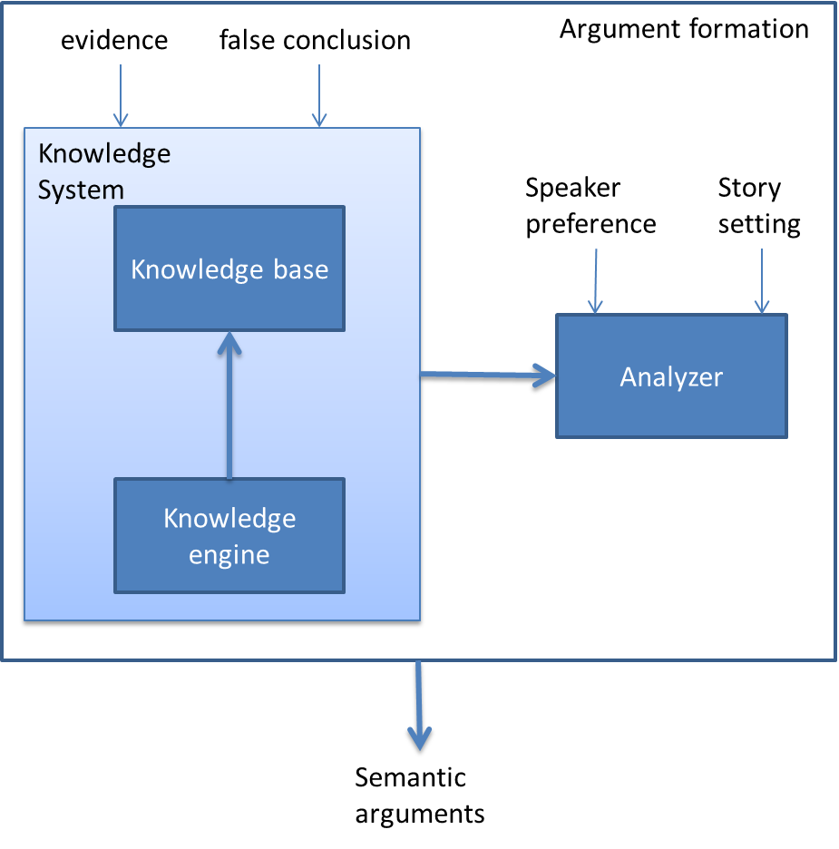
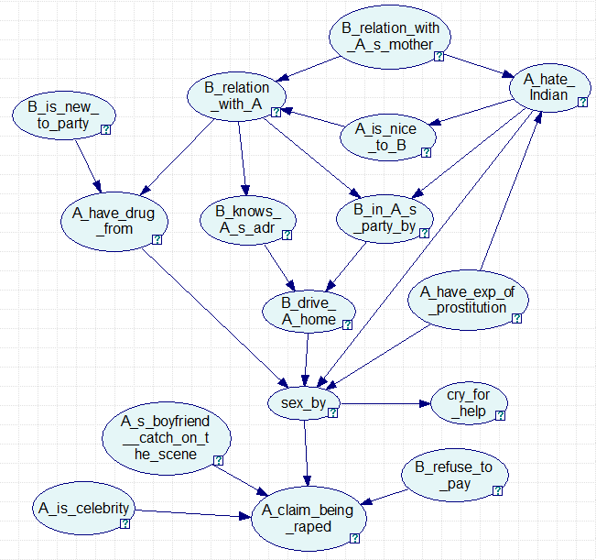
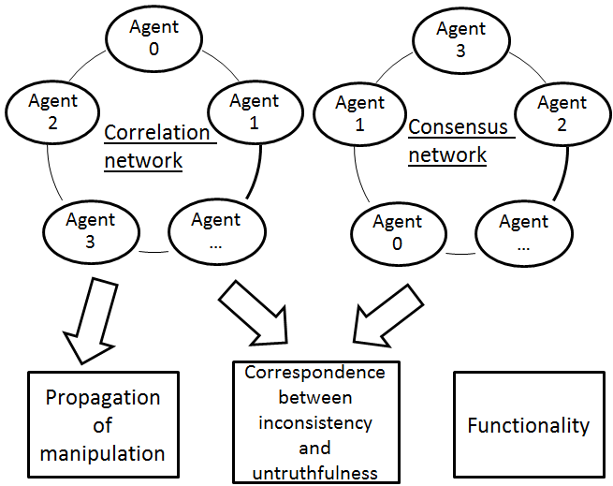
Argument Formation in the Reasoning Process: Toward a Generic Model of Deception Detection f
Deqing Li , Eugene Santos, Jr. —Dartmouth College, Hanover, N.H, U.S.A
Cognitive Process of Deception
We propose that the act of deceiving is to reason by supposing the truth of deceivers’ targeted arguments, but the truth of the targeted arguments is not actually believed by the deceivers.
Date Collection and Simulation
Story:
A female celebrity coded as A claims that she was raped by an Indian young man coded as B. A claims that she keeps away from B because both her and her mother do not like the physical odor of Indians. A claims that B once joined her birthday party without any invitation and fed A drugs. B then conveyed A home and raped A. After A’s boyfriend arrived, A called police. However, the truth is that B is a fan of A and joined A’s party at A’s invitation. A lied about her aversion to Indians because she used to prostitute to Indians. Besides, B is new to the party club, so it is unlikely for him to obtain drugs there. A used drugs and enticed B to have sex with her.
Reasoning process built by Bayesian Network:
Fundamental Discrepancies in Deception
Discrepancies in arguments that deceivers are reluctant to believe but truth tellers embrace can be expected.
Discrepancies in arguments that are manipulated by deceivers can be expected.
Hypotheses and Justification
Explicit manipulations in deception continuously propagate to other arguments which become implicit manipulations. The purpose, of course, is to spread the manipulation to the conclusion.
There is a correspondence between inconsistency and untruthfulness, which demonstrates two types of incredibility of deception: Type I, incredibility due to over-manipulation; Type II, incredibility due to ignorance.
Deceptions are intentional, which means the deceiver assumes the conclusion before inferring the whole story
Computational Model
Correlation Network connects acquaintances who can anticipate each other’s arguments. It predicts an agent’s belief according to neighbors who can expect each other.
Consensus Network connects people who agree with each other. It compares the deceiver with the truth tellers.
Reasoning results simulated by Bayesian Network:
Arguments | Decept. | Honest | True
B_relation_with_As_mother | bad | bad | bad
A_have_exp_of_prostitution | unknn | T | F
A_hate_Indian | T | F | T
A_is_nice_to_B | F | T | F
B_relation_with_A | rape | fan | rape
B_in_A_s_party_by | self | unknn | self
B_knows_A_s_adr | T | T | T
B_drive_A_home | T | T | T
B_is_new_to_party | T | T | F
A_have_drug_from | B | self | B
sex_by | rape | entice | rape
As_boyfriend_catch_on_the_scene | T | T | T
A_is_celebrity | T | T | T
B_refuse_to_pay | T | T | unknn
A_claim_being_raped | unknn | T | unknn
cry_for_help | T | F | T
Experiment Results
It demonstrates that manipulations propagate to closely related arguments (e.g. A_hate_Indian). Unrelated arguments (e.g. B_is_new_to_party) are probably considered as irrelevant or simply be ignored by the deceiver.
Significant manipulations are often convincing and unconvincing arguments usually can be found in slightly manipulated or ignored arguments.
All but one manipulated arguments in the deceptive story are functional to the conclusion and evidence, but none of the inconsistent arguments in misinformative stories is.

